Slide 1
English Writing II
Week 2 Combining different materials
2020.3.4

Slide 2
Lesson plan
Review of the writing task (A Typical Day)
Mini-sample in close-up (structure and vocabulary)
Nature’s Bioterrorist (first reading)
Homework

Slide 3
Review of the diagnostic writing
A Typical Day in the Time of Coronavirus

Slide 4
Stories of us …
快递小哥的一天
医生护士的一天
李文亮的最后一天
奶奶去买菜
奶奶去站岗
爷爷去站岗
我是志愿者
爸爸去驰援
妈妈去驰援
姐姐在前线
叔叔在路上
我快闷死了
我被隔离了
我爱直播课
我会做饭了
抢购口罩
抢购大米
抢购电热毯
抢购双黄连

Slide 5
Vocabulary
Community/neighborhood security
Grocery shopping, panic shopping
Out of stock, stockpile, hoarding/ hoarder
Armed to the teeth
Exposure to the virus/ risk

Slide 6
Review: general comments
Perspective – who? (identity, stance, attitude, tone)
Focus – what (message, theme, image)
Structure – a story-line (not a running account)
Choice of words and readability

Slide 7
Review: writing strategies
SELECTIVE: Write with a clear focus and purpose
DETAILS: Show, don’t tell.
ARGUE with reasons and evidence
SET the story in a bigger context

Slide 8

Mini-sample in close-up: Structure
Describing the big picture (the time of coronavirus)
A mini-sample: CGTN Report (2.12).mp4
Close-up analysis: CGTN Report (Script).docx

Slide 9
Mini-sample in close-up: Vocabulary
the epicenter of the virus outbreak
to see China’s efforts in a different light
the capacity to mobilize resources
medical staff were pooled to help Hubei
to self-isolate at home
the medical staff and first responders
the unsung heroes who deserve the most credit

Slide 10
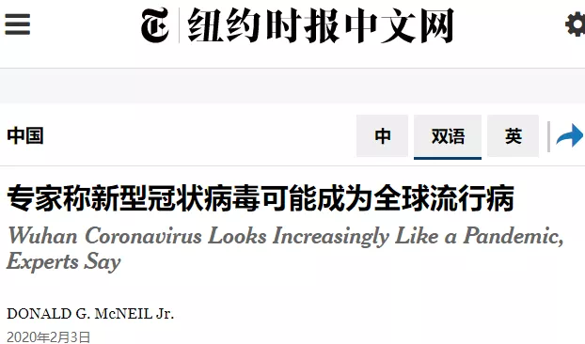
Not a global pandemic yet …

Slide 11
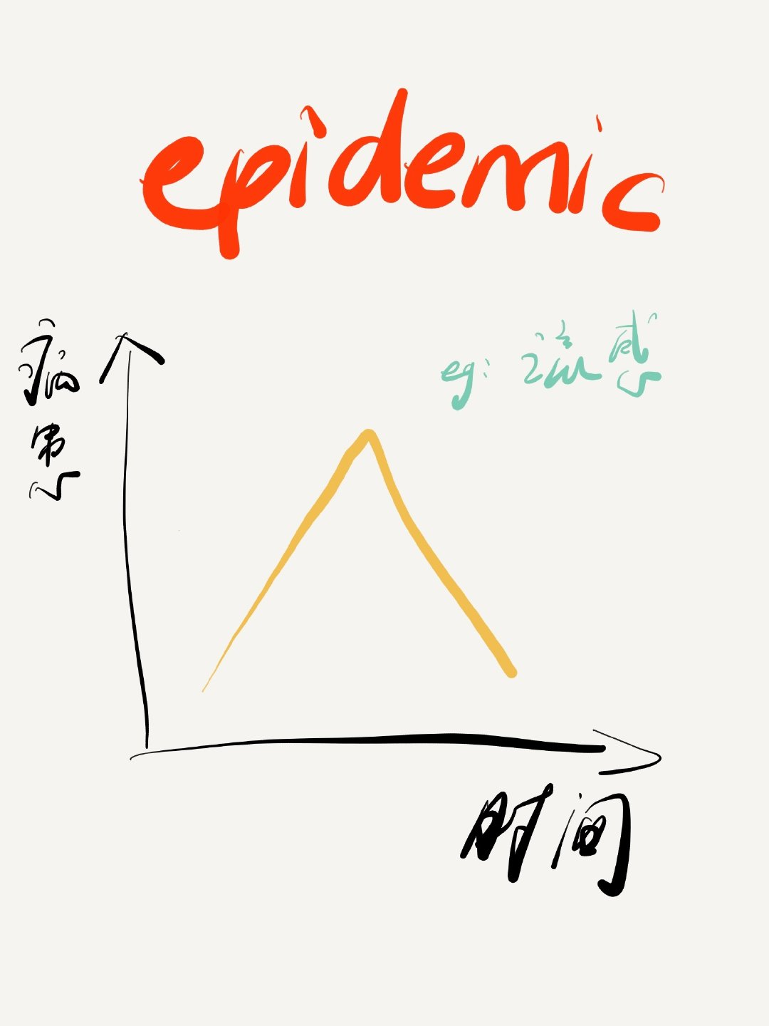
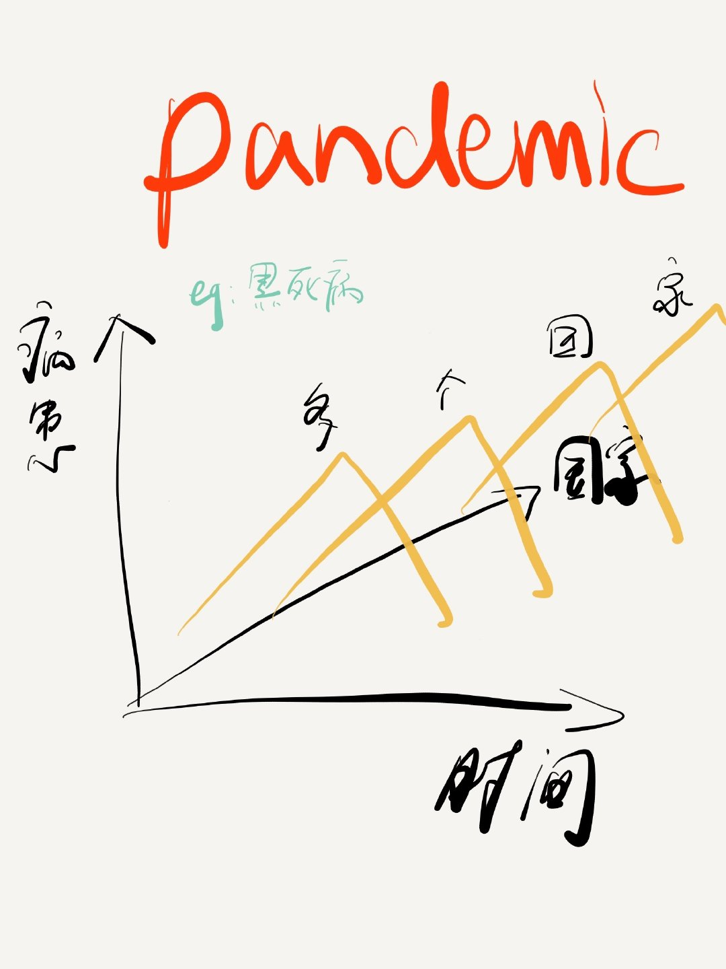
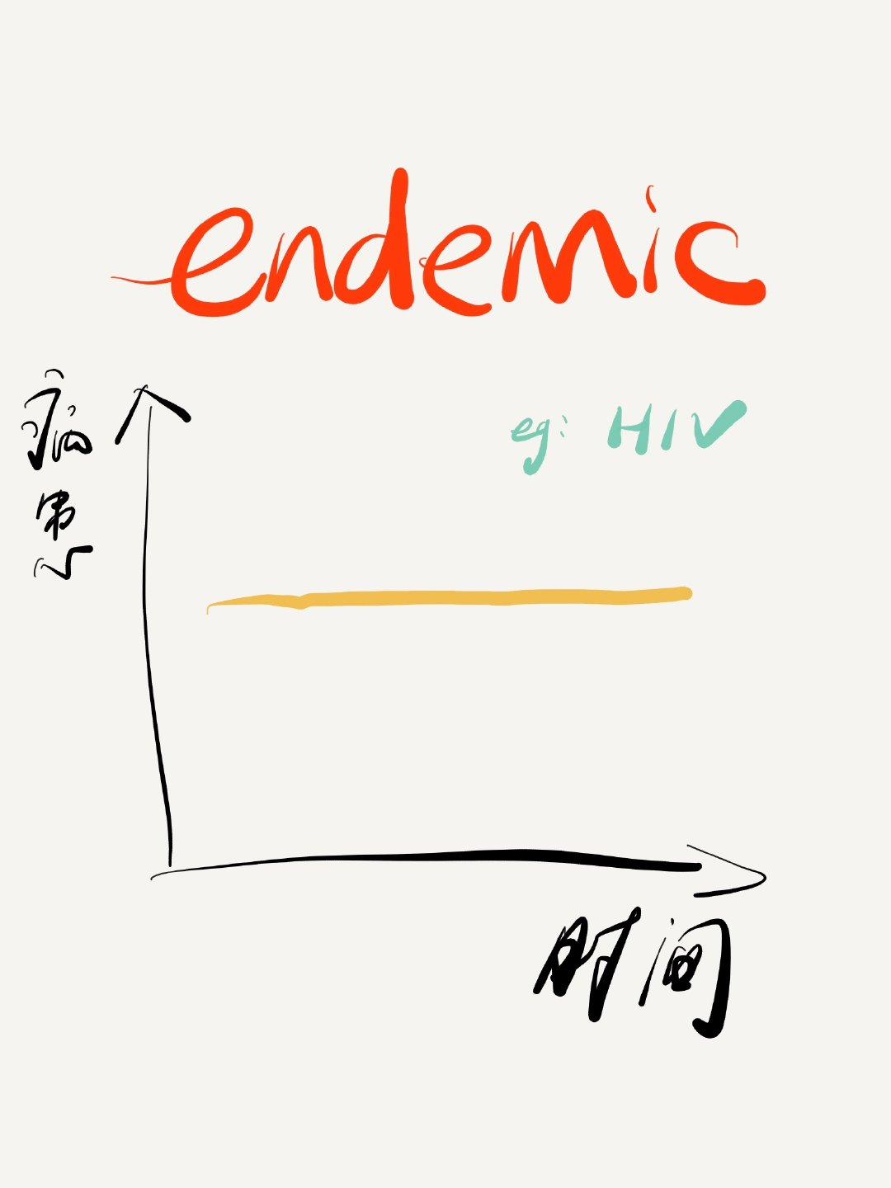

Slide 12
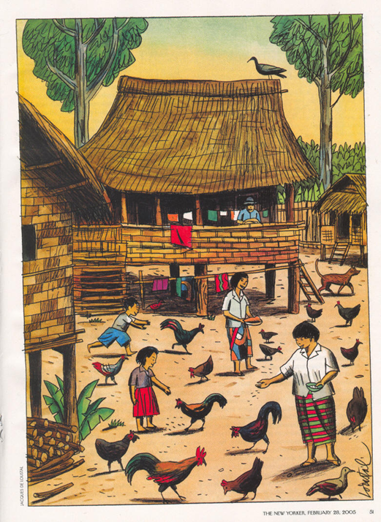
Nature’s Bioterrorist: the background
The New Yorker
A Reporter at Large
Michael Specter

Slide 13

Major events
H5N1 human and animal cases in Thailand in 2004-2005
Impact on poultry business in Thailand
Avian flu cases and responses in Hong Kong (1997-1998)
SARS outbreak in Hong Kong in 2003
Reactions of governments and health authorities to the flu
*Science facts, data, and interviews

Slide 14
Homework: Close-up reading
Careful reading of the first major event (p.50-53 )
Analysis of different materials (facts, stories, data, opinions)
How are they related in a coherent and logical unity?

Slide 15
Homework: Research on COVID-19
Three science facts (textbooks, encyclopedia, etc.)
Three quoted data (government reports, research institutions, other reliable sources)
Three quoted opinions (media outlets, personal interview, other reliable sources)
! Submission within 24 hours

